Slide 1
Sweden and the European Chips Act
Power Electronics Day 2024

Slide 2
Vinnova
Sweden’s Innovation Agency

Slide 3
Innovation
Innovation is more important than ever, and we’re running out of time
Notes:
Corona, climate change, a growing population and depletion of natural resources.
We’re facing great challenges and we have to think and act differently.
We know that we need to transform our entire society, our cities, our welfare, our value chains and consumption patterns into something sustainable.
Innovation is more important than ever.
And we’re running out of time.
Vinnova is Sweden’s innovation agency
Our instructions state that Vinnova’s task is to promote sustainable growth by financing needs-based research and development of effective innovation systems.
Our mission (simply put) is to enable innovation that makes a difference.
A difference to the planet and a difference to Sweden’s economy and prosperity.
Innovation is the only way for us to maintain our competitiveness, create well-paying jobs and safeguarding the Swedish welfare state in the long term.
We need to promote innovation that is sustainable for our environment, for our society and for our economy.

Slide 4






We need innovation in the broadest sense
The world is facing complex challenges
Notes:
In order to achieve the goals, we need to promote innovation in the broadest sense of the word.
Innovation to create new products and services is not enough, we also need innovation in our working methods, innovation to change our behaviours and habits as well as innovation in terms of how we can work better together in complex ecosystems with actors from business, politics, civil society, as well as the public and academic sectors.
We need innovation at all stages to transform entire systems and make the transition to a sustainable future.
In brief, we need to create the conditions for what we call system innovation – which allows us not only to face our challenges but also create a society that is better for all of us to live in.
It makes Sweden more competitive and makes a difference for the world.

Slide 5

3,4 billion SEK
Our role as a funder is significant
Notes:
Our role as a funder is significant.
2023 Vinnova funded projects for a total amount of 3,4 billion SEK
As innovation is needed throughout society, the projects we fund span many areas of society and sectors, both in privately and publicly funded activities.
It can be anything from project to promote social and norm-critical innovation to innovation in the mine with 5G technology.
Our funding reaches many. Companies, universities, institutes, non-profit organizations and the public sector.

Slide 6
Global cooperation is crucial
For a sustainable future
Notes:
Innovation and global cooperation are a crucial for creating a sustainable future.
We have both innovation collaborations with a number of countries and are the liaison authority for the EU framework program for research and innovation.
In our role as funder, we work with Horisont Europa, the EU's framework program for research and innovation.
Innovation is increasingly taking place in international networks and our business community also operates most often in an international market.
Therefore, it is central to our entire activities have an international perspective on what we do.
We are 200 employees in Sweden but work internationally with staff or strategic partnerships in Brussels, Silicon Valley and Tel Aviv, among others.
We connect companies and organizations in Sweden with actors in other countries and promote international collaborations in research and innovation.
We work actively to make the international perspective a natural part of our entire activities.

Slide 7


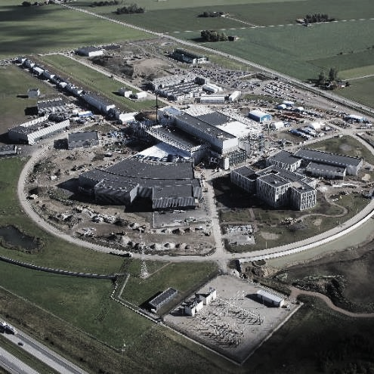
We are the link to EU funding
Horizon Europe
Notes:
We are the link to EU funding
In our role as funders, we also work with Horisont Europa, the EU's framework program for research and innovation.
The program is the world's largest effort on research and innovation and has a total budget of around 95 billion euros.
Horisont Europa means significant funding opportunities for Swedish research and innovation actors as well as opportunities to participate in European collaborative projects for technology development and solutions to societal challenges.
Vinnova has the role to disseminate Horisont Europa in Sweden and helps organizations to seek EU funding for their project.
Swedish organisations were granted more than EUR 2 billion under 2014-2020, corresponding to 3.4 per cent of allocated funds, which makes Sweden one of the ten most successful countries in the framework program.

Slide 8

Chips Joint Undertaking

Slide 9


Chips Act implementation in Sverige
Pillar 1
Chips for Europe Initiative
Initiative on infrastructure building in synergy with the EU’s research programmes
Support to start-ups and SMEs
Pillar 2
Security of Supply
First-of-a-kind semiconductor production facilities
Pillar 3
Monitoring and Crisis Response
Monitoring and alerting
Crisis coordination mechanism with MS
Strong Commission powers in times of crisis
Chips JU:
Competence Centre
Pilot Lines
Design Platform
Notes:
The European Chips Act, as proposed on 8 February this year, is structured in three pillars.
Pillar 1, the Chips for Europe Initiative, covers the infrastructure building and support for startups and SMEs
Pillar 2 focuses on the Security of Chips Supply for the Union, funding the development of first-of-a-kind production facilities across Europe. It is important to mention that first-of-a-kind does not refer to the final product only, it can also mean an innovation in the production process, for example making it more energy-efficient.
Pillar 3 is about Monitoring and Crisis Response and foresees a coordination mechanism among Member States and including like-minded countries in order to avoid future chip shortages (even more relevant today considering the recent US export controls and the geopolitical situation in Taiwan).
Vinnova represents SE in Chips JU
Tillväxtverket represents SE i Semiconductor Board (EC och ME)

Slide 10
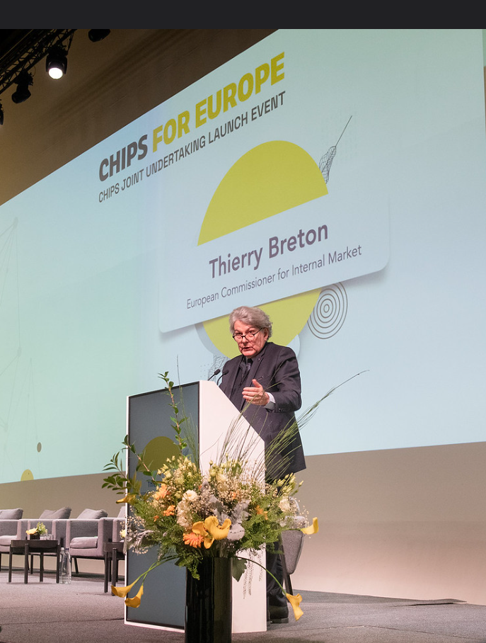
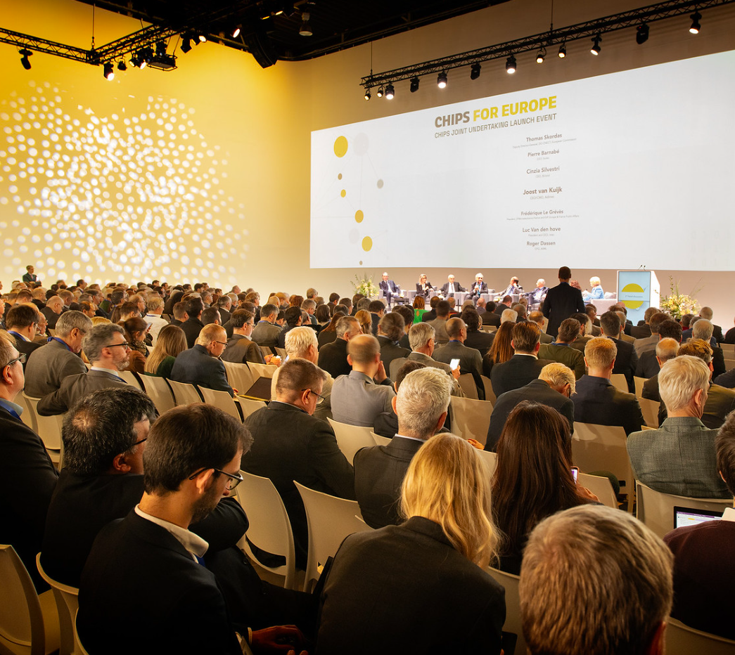

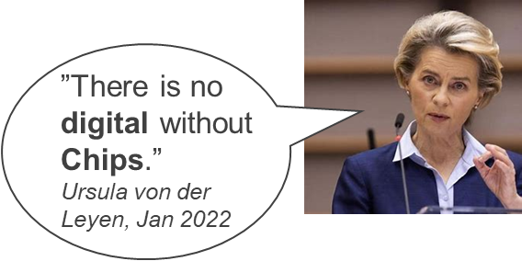
EU Chips Act: mobilisering av över 43 miljarder euro av offentliga och privata investeringar
Notes:
Chips JU launch event in December 2023 in Brussels. Large programme with the EU's most important R&I efforts within ECS, including quant technologies. Chips Act will mobilize more than 43 billion euros of public and private investments.

Slide 11

Chips Joint Undertaking
Pilot lines
(start 2024)
Budget from DEP and HE
Quantum pilot lines (start 2025-2026)
Chips for Europe Initiative
Competence Centres
(start 2024)
2023-2027
Design Platform
(start 2025)
Budget from DEP
Skills
(started 2023)
Operational budget (Horizon Europe & Digital Europe Programme):
EUR 4 175 million
Research and innovation projects (RIA, IA, CSA)
Budget EU Commission (Horizon Europe):
EUR 1 300 million
Research and Innovation actions
Research and innovation cooperation projects

Slide 12
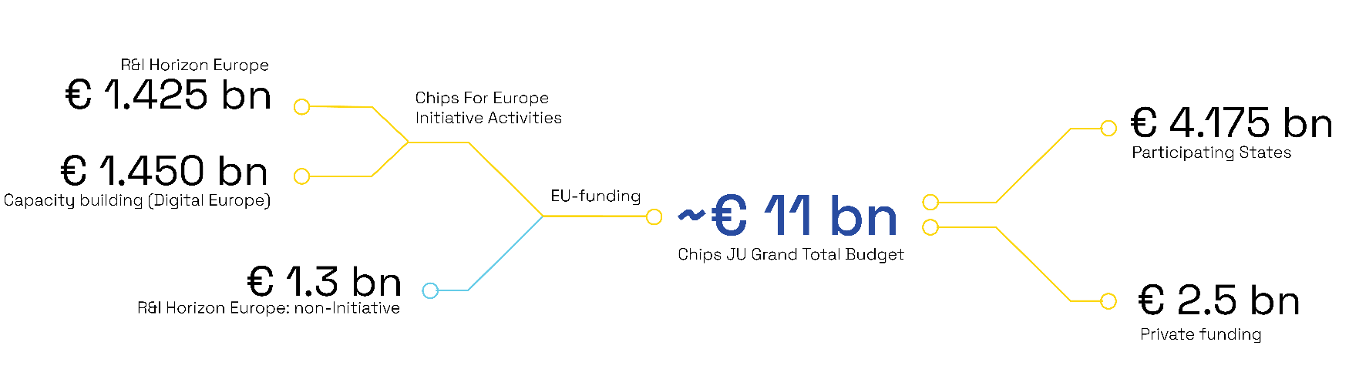
Chips JU
EU Contribution to Chips JU (excl | Chips for Europe Initiative | Non-Initiative | Total
R&I (Horizon Europe) | 1.425 | 1.300 | 2.725
Cap building (DEP) | 1.450 | n.a. | 1.450
Total | 2.875 | 1.300 | 4.175

Slide 13
Swedish delegation in Chips JU
Adela Saavedra Granholm, main delegate PAB, alternate GB
Lars Gustafsson, main delegate GB, alternate PAB
Jessica Svennebring, alternate PAB & GB
Sverker Brundin, alternate PAB & GB
PAB: Public Authorities Board.
GB: Governing Board.

Slide 14
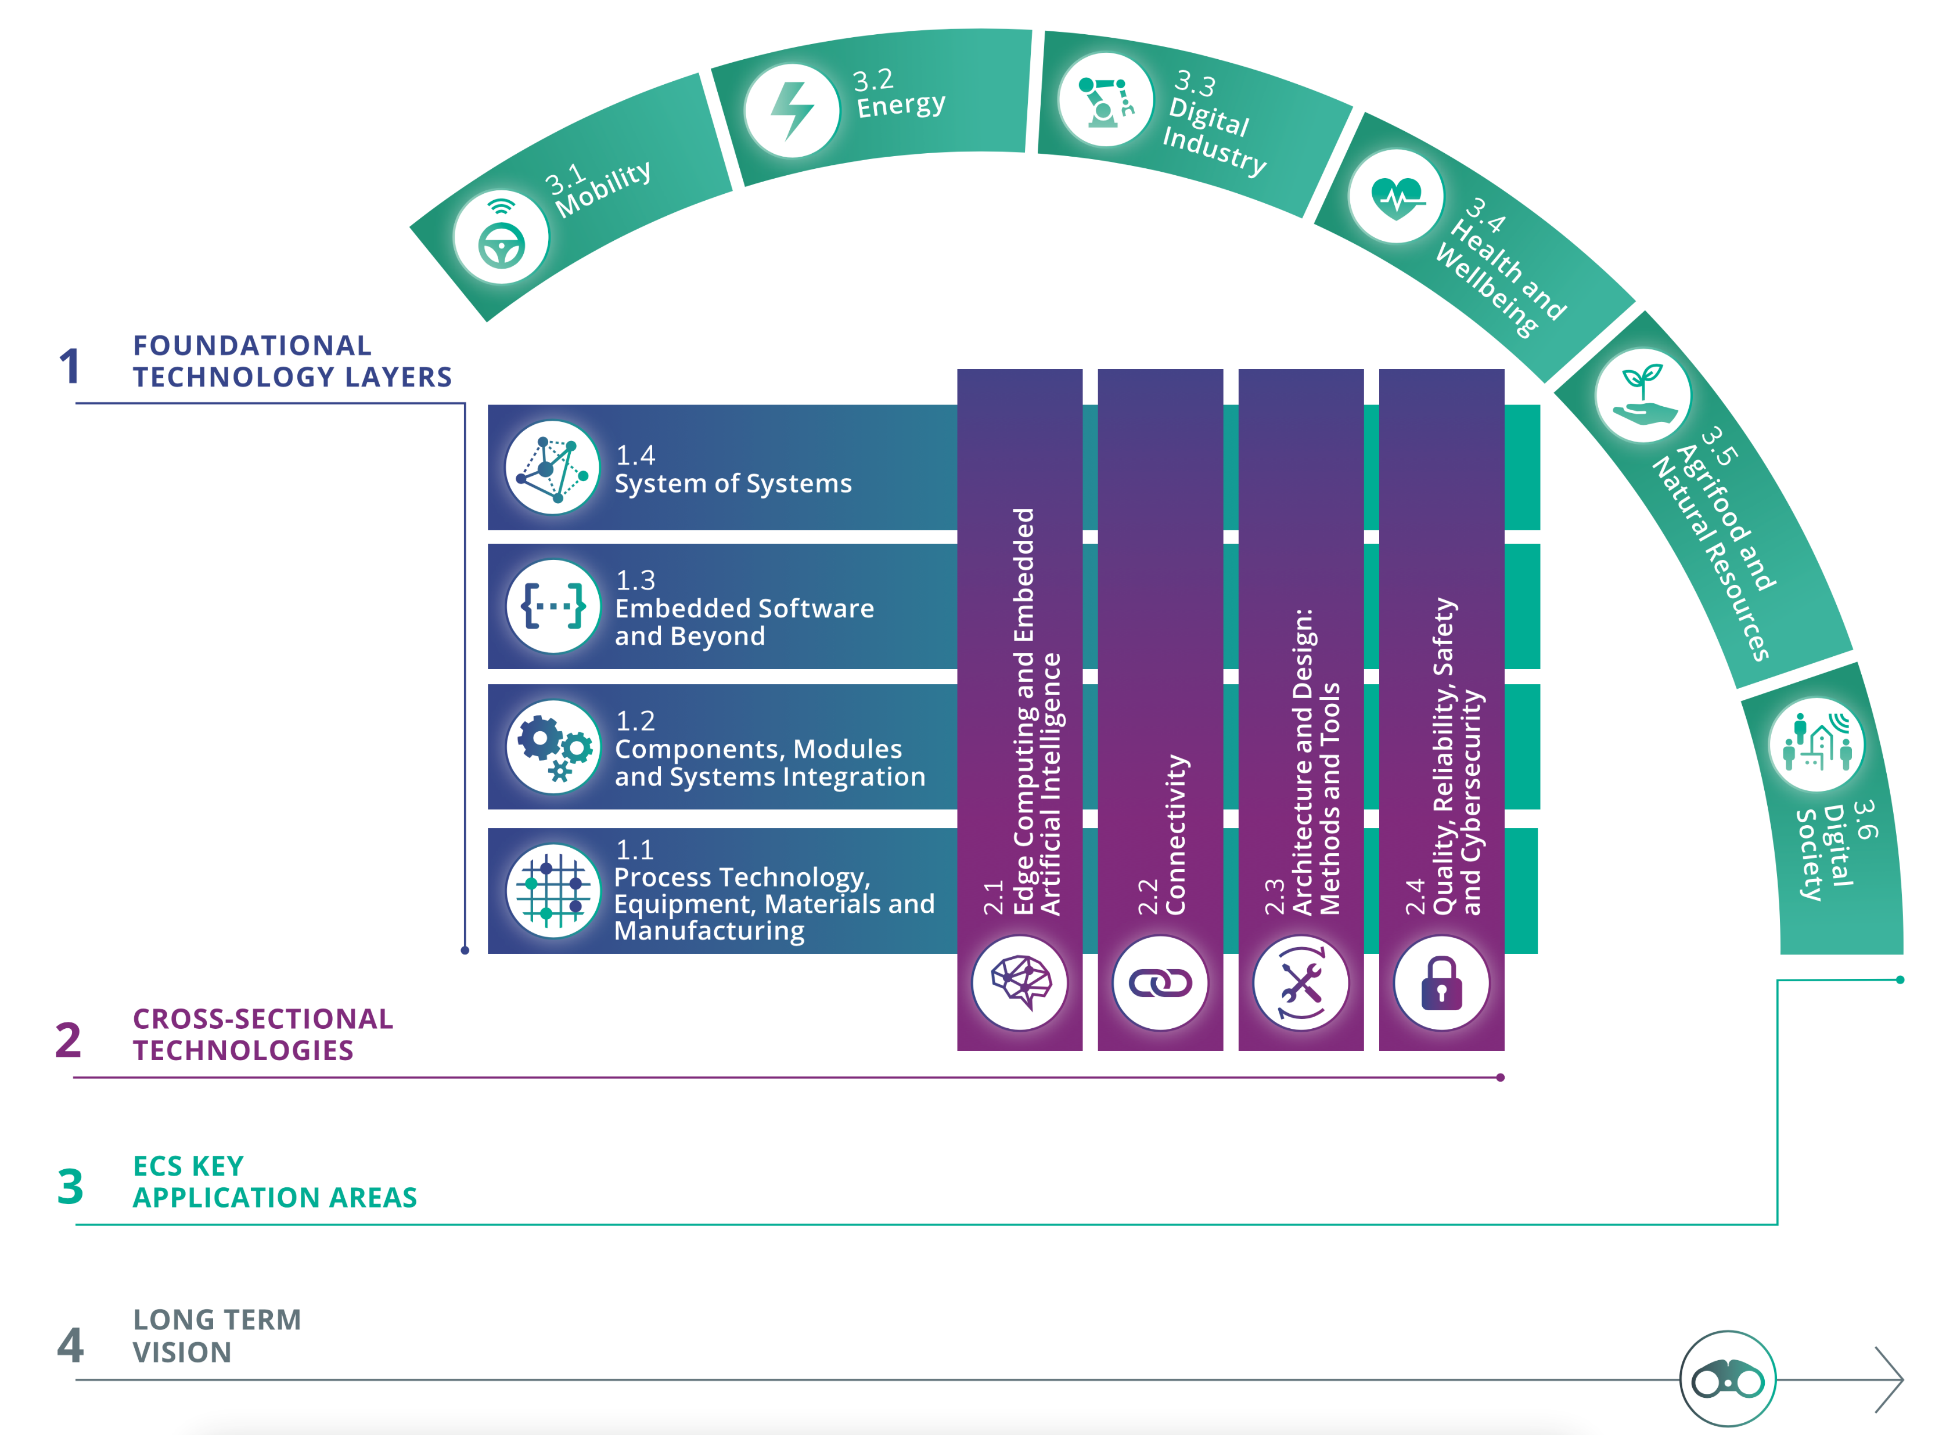
Chips Joint Undertaking
Chips JU is a Horizon Europe institutionalized partnership program
It is financed by the European Commission, funding national authorities (MS and associated countries) and participating organizations.
Vinnova finances collaborative projects with organizations along the entire value chain from semiconductor circuits and electronic components to systems of systems (SoS).
The areas of application: mobility, energy, digital industry, digital infrastructure and communication as well as digitalization in agriculture and forestry, health and digital society.
ECS SRIA 2024 | ECS SRIA

Slide 15
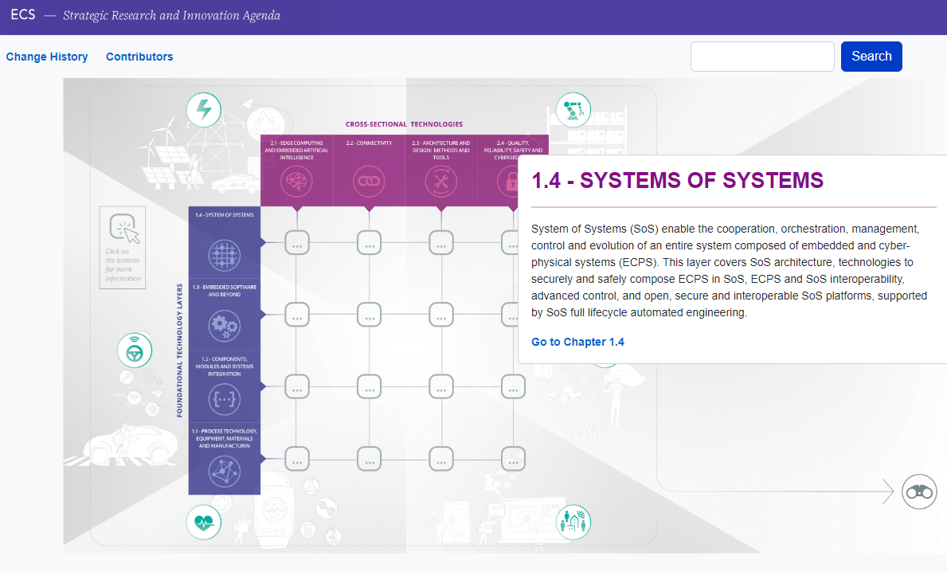
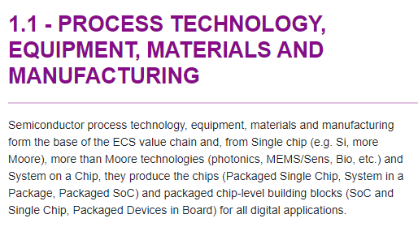
Strategic Research and Innovation agenda - SRIA
AENEAS
AENEAS - Association for RD&I in Electronic Components & Systems : Aeneas (aeneas-office.org)
Inside
Home | Inside (inside-association.eu)
EPoSS
EPoSS - The Product Driven Platform | EPoSS (smart-systems-integration.org)
Outline | ECS SRIA
Notes:
The program covers the entire chain from production processes and equipment, materials and production, chips to systems of systems. SRIA is updated every year. Produced by the 3 industry organizations (Aeneas, EPoSS and Inside) and approved by Chips JU PAB.

Slide 16
Chips JU Non-initiative Calls 2024
Action | Topic | Estimated EU Expenditure | Vinnova's budget
HORIZON-Chips 2024-1-IA T1 | Global call according to SRIA 2024 (IA) | 103 | 3
HORIZON- Chips 2024-1-IA T2 | Focus topic on “High Performance RISC-V Automotive Processors supporting SDV” | 20 | 0
HORIZON- Chips 2024-1-IA T3 | Focus topic on “Service Oriented Framework for the Software Defined Vehicle of the future” | 20 | 0
HORIZON- Chips 2024-2-RIA-T1 | Global call according to SRIA 2023 (RIA) | 52 | 3
HORIZON- Chips 2024-2-RIA T2 | Focus topic on “Sustainable and greener manufacturing” | 15 | 0,6
HORIZON- Chips 2024-3-RIA | Joint call with Korea on Heterogeneous integration and neuromorphic computing technologies for future semiconductor components and systems | 6 | 0
 | Total | 216 | 6,6
Financing from Horizon Europe programme.
IA = Innovation Action
RIA = Research & Innovation Action Currency = EUR

Slide 17
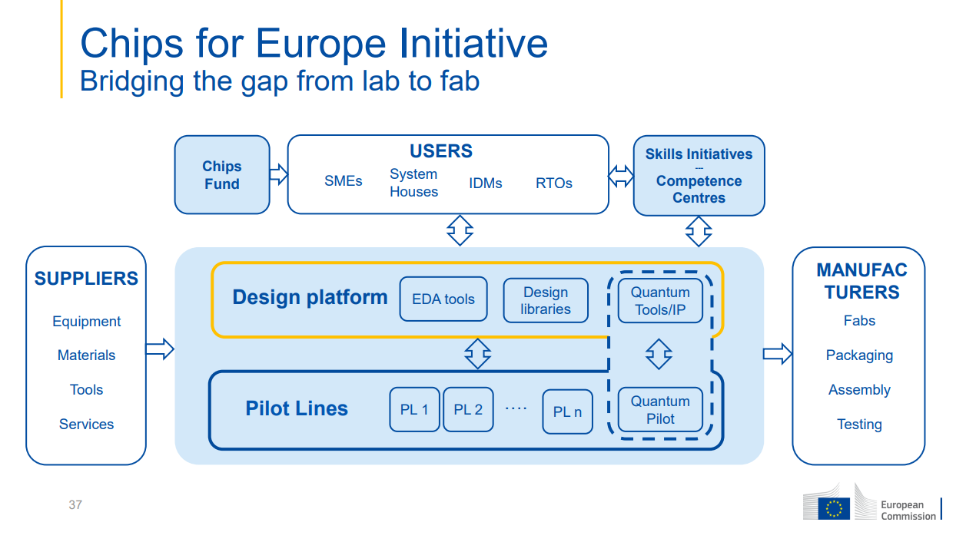
Notes:
The setting up of a network of competence centres is one of the five objectives of the Chips for Europe Initiative. As we can see in this graph, the role of competence centres will be crucial, serving as a bridge between the infrastructures and their users whenever this is not directly or easily available. Through the network of competence centres, SMEs and other users will have prioritised access to the design platform and the various pilot lines that will be set-up.

Slide 18
European Network of Competence Centres
EU and national funding (2025 - 2028)
Focus om SMEs and start-ups.
Training in chip design. Cooperation within the network is important and with other efforts such as e.g. Europractice.
Support users to access the Design Platform
Training of the semiconductors ekosystem including further training of engineers and developers in a special "train the trainer" programme.
Support users to access the Pilot Lines
Collaboration with pilot lines in Chips JU for support and access to users.
Collaboration with other so-called Competence centers (Cybersecurity, EuroHPC) and EIDH.
Promote Chips Fund and facilitate access to risk capital.
Promote "success stories"
Notes:
Training in chip design: there is a major shortage of design skills in Europe. Here, the Competence Center will have a special role. Cooperation within the network is important and with other efforts such as e.g. Europractice.
Access to pilot lines in Chips JU. Provides support to users to find the right pilot line that meets their needs and facilitate access to it.

Slide 19
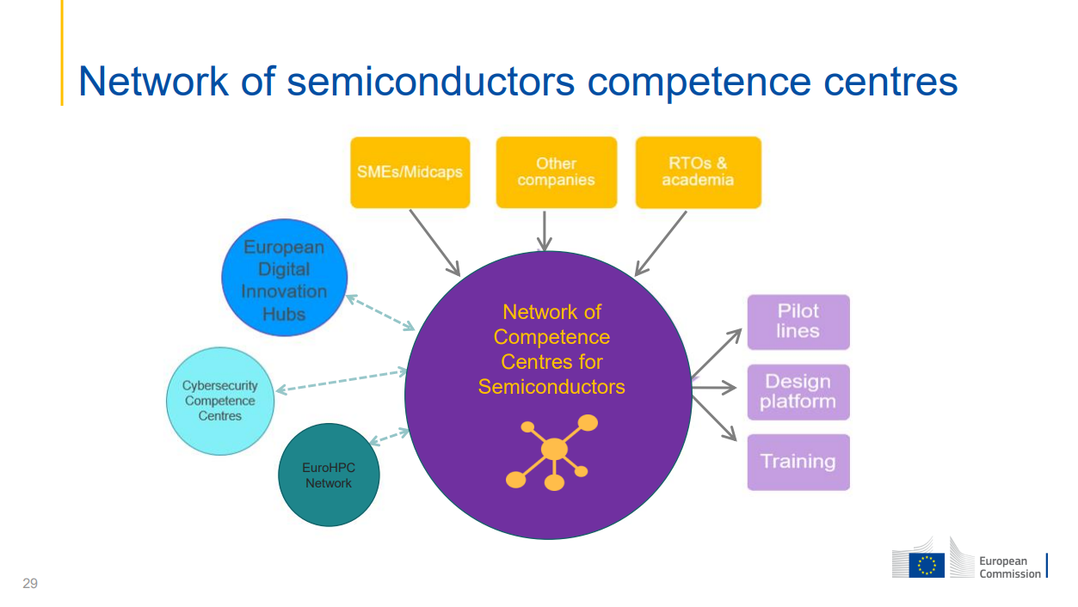

Slide 20
Chips JU Pilot Lines
From the lab to the fab
EU and national funding (2024 - 2028)
PL1: NanoIC European pilot line for beyond 2nm leading edge System-on-Chip leadership
PL2: FAMES – FD-SOI Pilot Line for Applications with non-volatile embedded Memories, RF & 3D integration
PL3: AHSI PL Advanced Heterogeneous System Integration
PL4: WBG Pilot Line
Swedish participation (KTH, Lunds univ., Chalmers and Linköping univ.)

Slide 21
Chips JU Pilot Lines
Competence Centres
Users
SMEs design houses Verticals RTOs
Design Platform
EDA tools
Design libraries
PL1: NanoIC
Suppliers
Equipment
Materials
Services
PL2: FAMES
Pilot Lines
AHSI PL
WBG PL
Virtual Prototype
system
exploration and validation
Functional demo
Design infrastructures

Slide 22
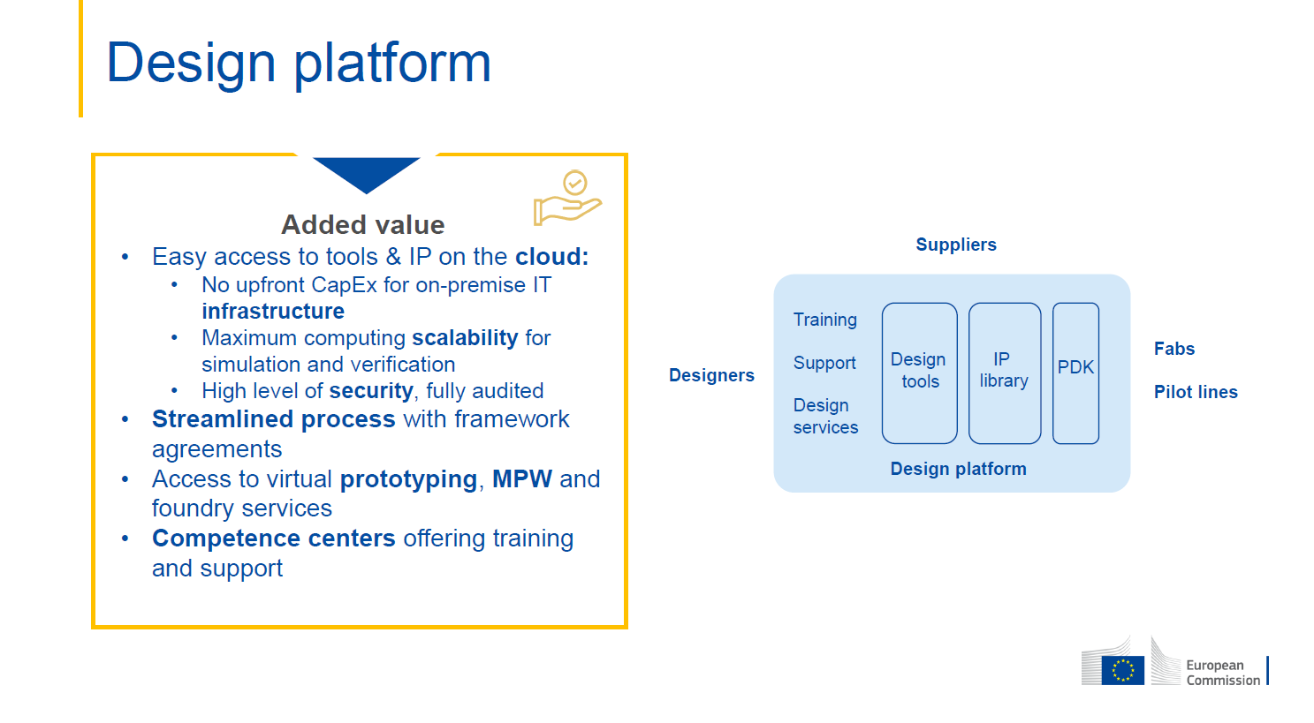
First call: July 2024
First trial projects Q4 2025
First projects 2026
EU and national funding

Slide 23
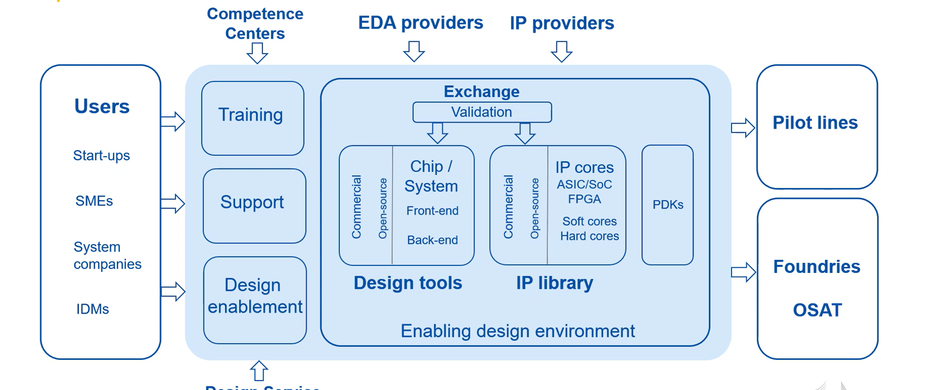
Design Platform

