Slide 1

Growth in the semiconductor sector
Silicon carbide wafer
Björn Langbeck, 16th May 2024
bjorn.langbeck@tillvaxtverket.se

Slide 2

Swedish semiconductor situation
As we described in our report in nov 2023
Swedish areas of interest
  Power electronics
  Quant computing components
  Prototype production in conjunction to research (MyFab)
  Chip design, MEMS and 6G
  Niche production of components for chip production equipment (suppliers to ASML)
No specific national budget for public support for investments in chip production
  We proposed a larger budget for pillar I (Vinnova)
No large scale FABs are present nor foreseen

Slide 3
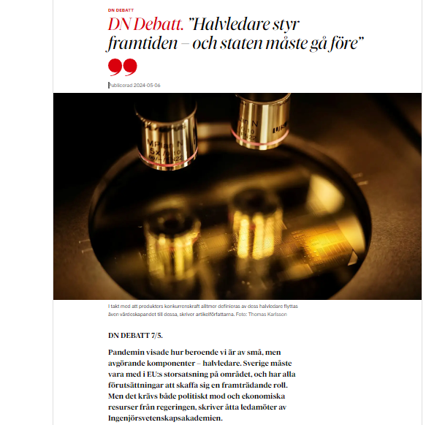
Others share our assessment of the situation
Industry and academy have presented basically the same future at DN Debatt as we in our report.
The message from the writers is very clear – Sweden has a good position and possibilities for growth in the sector, but public money is lacking.
Tillväxtverket has a meeting next week with the Ministry of Climate and Enterprise

Slide 4
Future production
Possible investments for upscaling
Tillväxtverket (The Swedish Agency for Economic and Regional Growth)
  Is responsible for pillar 2 and 3 of the ECA
  Tillväxtverket are members of the European Semiconductor Board (ECB)
As far as we know one company is going to apply for IPF, none for OEF
Public support will be handled within ordinary structures
The investments in Swedish production are within the strengths Sweden has
  Power electronics (SiC, GaN)
  Optoelectrical
  MEMS
  Quant computing

Slide 5
Call for projects to strengthen the Swedish semiconductor infrastructure
A national possibility within ERDF will open in august
  Information meeting 30th May at 13.00-14.00 (on-line)
  Follow up meeting 18th June at 08.30-09.30 (on-line)
The new article 26a in GBER (EU 651/2014) is open for regions and national decisions
  This article can be used for decisions under this call
  Support for investment in research infrastructure will be possible

Slide 6
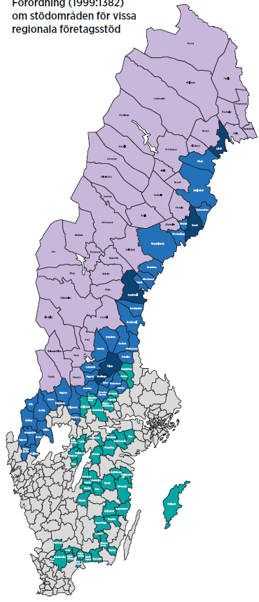
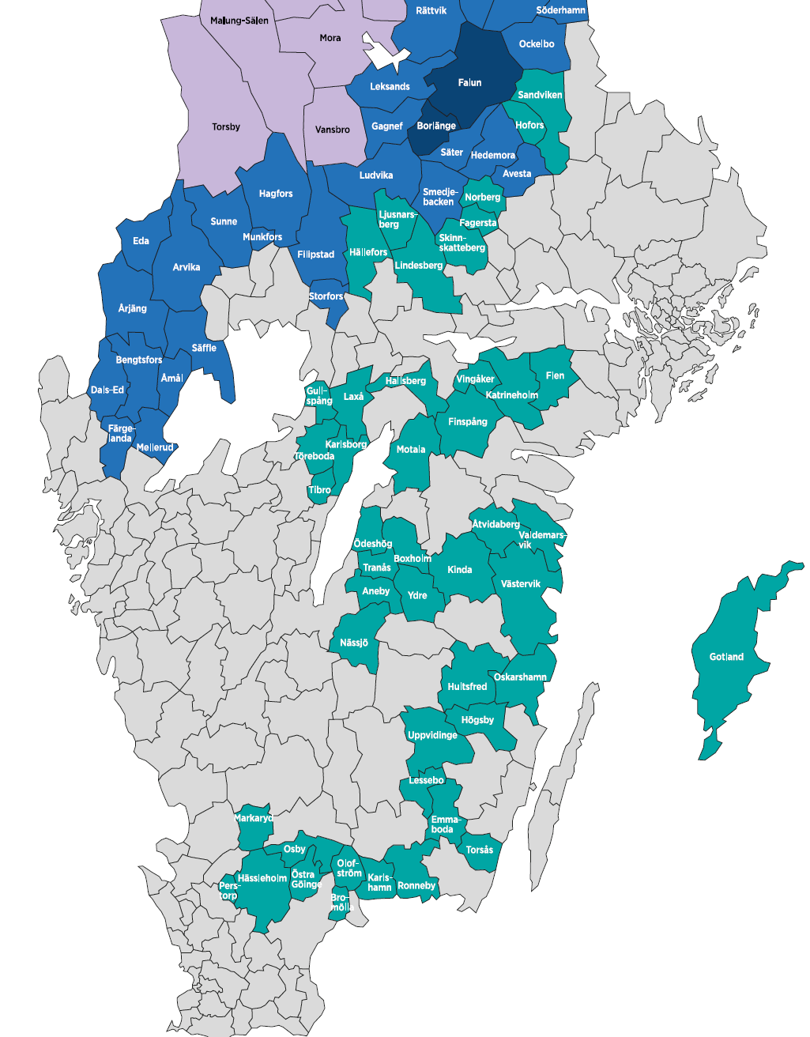
Public support for investments
Regular investment support in accepted municipalities
  The level of support differs according to colour
  No support within grey municipalities

