Slide 1
Mats Leksell, Div. Electric Power and Energy Systems, KTH
Stand-in Theme leader 2

Slide 2


The national research centre for electrification of transportation
An arena for Sweden’s industry, academies, and society to create new technology, insights, and competence for the future. An international distinguished centre of excellence, renowned for its competence building, research, and development of sustainable technology for electrification.
Established 2007
Stage V 2022–2027
4
Notes:
ANNA

Slide 3
This is Swedish Electromobility Centre
The vision is that electromobility, together with renewable electricity generation, reaches its full potential for serving as a building block for the sustainable society of the future.
The mission is to accelerate the development and implementation of electric propulsion technologies into the transport ecosystem by maximising their applicability, and efficiency while minimizing their overall impacts on the environment, human health, and natural resources, and strengthen Swedish industry’s competitiveness.
5
Notes:
MARCUS

Slide 4
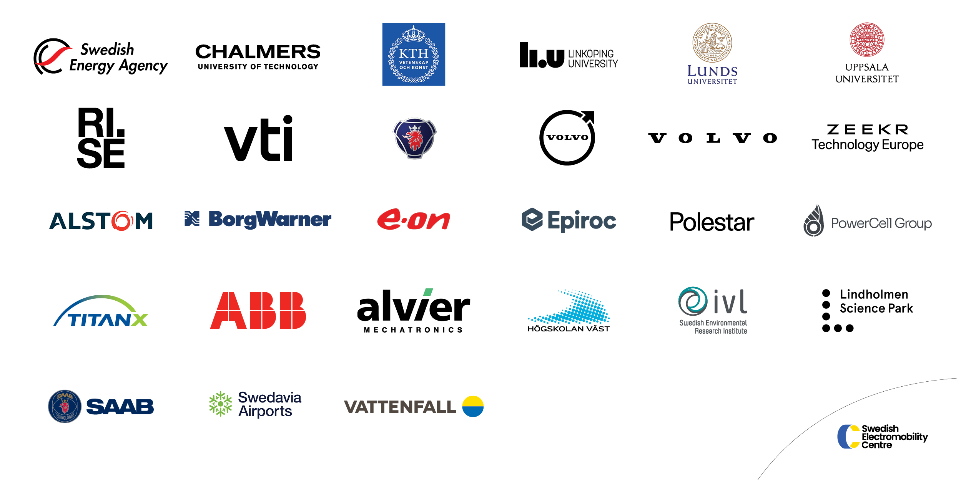
PARTNERS
Level 1
FULL PARTNER
Level 2
PROGRAM PARTNER
Level 3
NETWORK PARTNER
6
Notes:
MARCUS

Slide 5






THEME AREAS
On-board systems
Societal systems
7

Slide 6
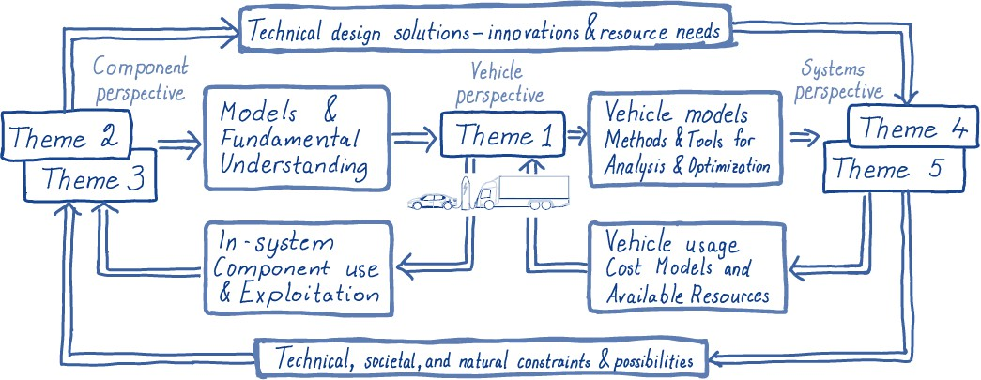
System Perspective on Electromobility
- How it all comes together
Illustration: Lars Eriksson
6

Slide 7


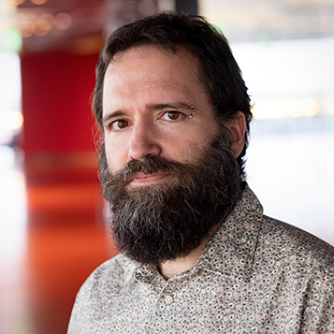
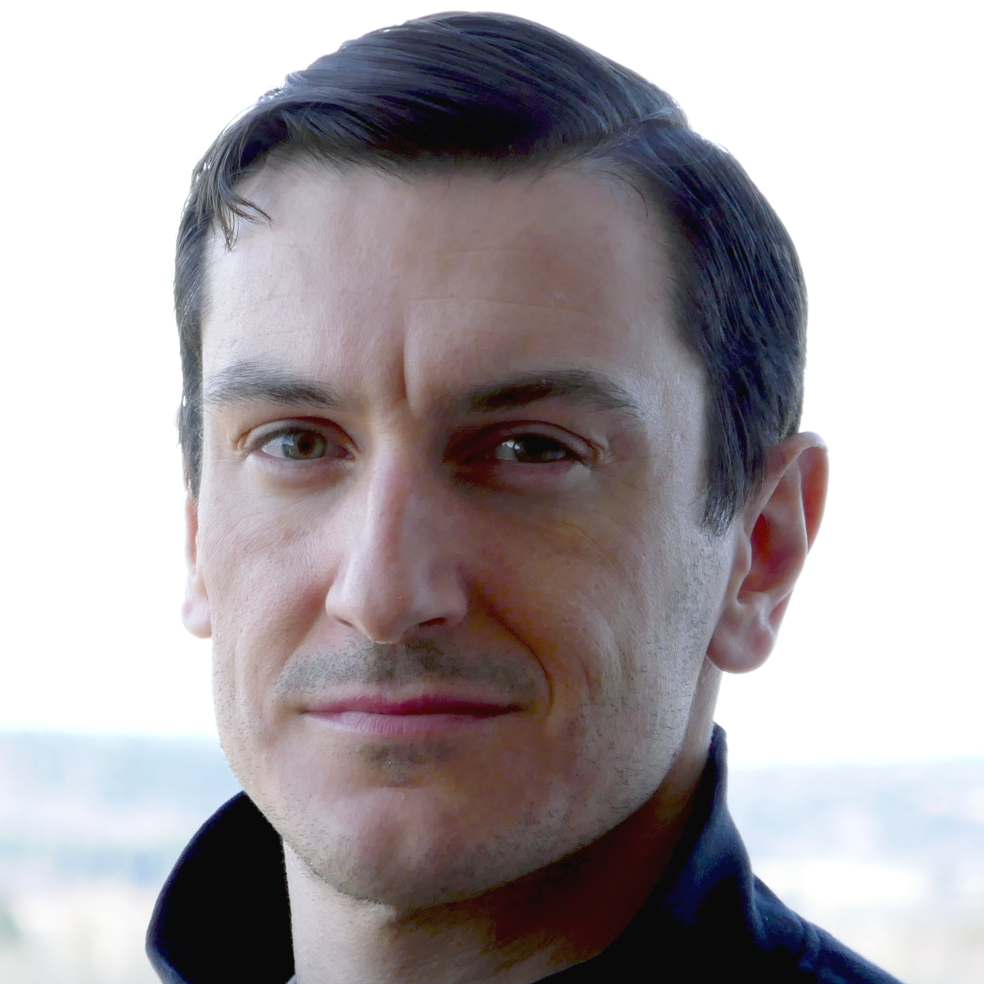
Areas of expertise
Our work is focused within our five theme areas: System studies and methods, Electrical machines drive systems and charging, Energy storage, Electromobility in society and Interaction between vehicles and grid.
THEME 2
Mats Leksell
KTH Royal Institute of Technology
Electric energy conversion: Power electronic traction converters, electric machinery, static and dynamic charging (electric roads).
Francisco Márquez-Fernández
Lund University
Luca Peretti
KTH Royal Institute of Technology

Slide 8

Areas of expertise
Our work is focused within our five theme areas: System studies and methods, Electrical machines drive systems and charging, Energy storage, Electromobility in society and Interaction between vehicles and grid.
Strategic research areas
Design of cost efficient, environmentally friendly electric drive systems:
  Reliability and fault tolerance
  Condition monitoring and diagnostics
  Manufacturing techniques
  Materials and recyclability
  New e-machine and converter topologies
Charging systems:
  On-board chargers
  Automation of the charging process
  Integration of charging equipment and the power grid (enabling V2x)
  Upscaling of charging infrastructure: EMC, power demand, load balancing.
Activities/tools
Electromagnetic design, thermal design, applied control theory, optimization, solid mechanics.
Partners
Uppsala University, KTH, Chalmers, Lund University, Linköping University, Högskolan Väst, AB Volvo, Volvo Cars, Scania, CEVT, Saab Group, ABB, BorgWarner, Epiroc, VTI, Vattenfall, TitanX, Alstom, Alvier Mechatronics, Swedavia Airports
10

Slide 9

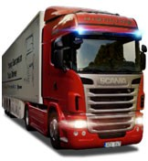
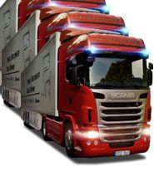


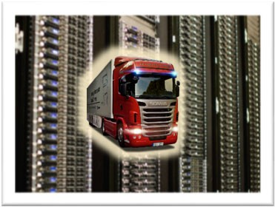


On-line health diagnostics of inverters for commercial vehicle drive systems
The goal of the project:
Realize synergies between
maintenance, vehicle
performance, spare-part
supply management, and product development
Expected result:
Methodology for estimating the
residual lifetime of key
components in drive inverters for commercial vehicles
Operational Data Degeneration indicators
Spare-part supply management
Electrical, thermal modelling
Component lifetime models
Evaluation
Vehicles in operation
Next-gen propulsion development
Suggested
Project leader: Staffan Norrga E-mail: norrga@kth.se
_{maintenanc}-_{e} Software modification
- Next maintenance event
Digital twin
action: - Performance modification
- etc.

Slide 10
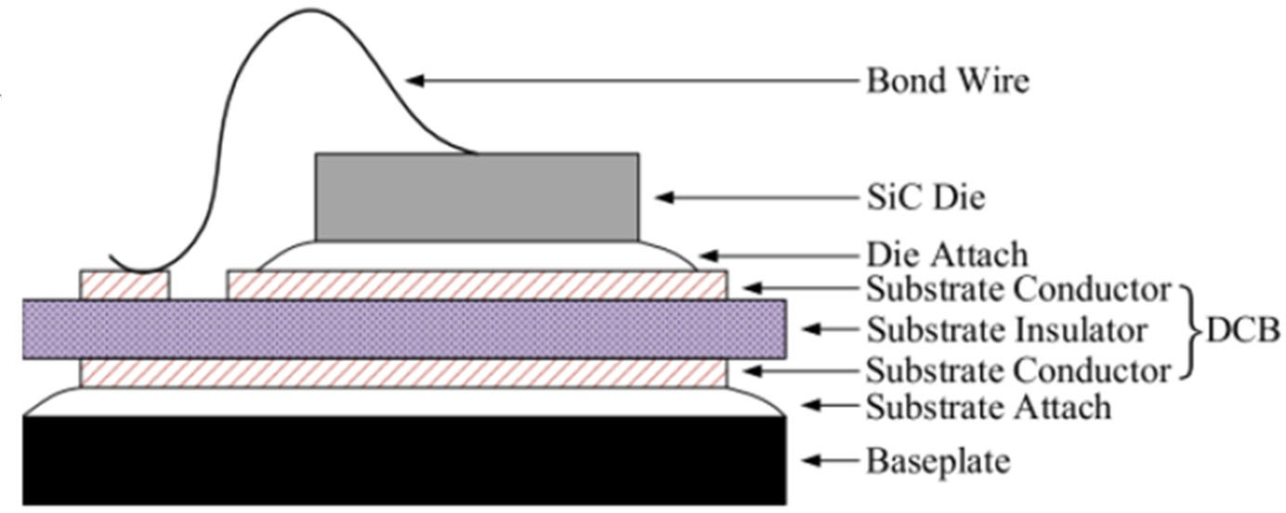
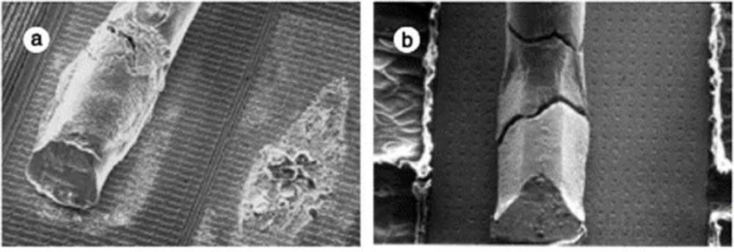
On-line health diagnostics of inverters for commercial vehicle drive systems
Power Modules
Failure Mechanisms
Power modules has layers of different materials.
Different layers have different thermal and mechanical properties.
Driving vehicle under various drivecycle produces thermal loading, which results in temperature swing inside the power module.
Due to different thermal and mechanical properties as well as temperature cycling, various thermo‐mechanical stresses are generated in between different interfaces.
Bond wire lift‐off and bond wire heel crack.
Solder layer degradation.
Metallization degradation.
Substrate layer delamination.
And many more…

Slide 11
SEC associated projects on reliability, design and high voltage
HEMIZERO – High power Electric Machine and Inverter for ZERO emission.
Megawatt Charging System (MCS) 1250 V, 3000 A
Powerized – Digitized and intelligent power electronics
Notes:
to develop breakthrough technologies of digitized and intelligent power electronics to enable sustainable and resilient energy generation, transmission and application

Slide 12
Associated projects
E-charge
Lund univ. in cooperation with Borg-Warner

Slide 13

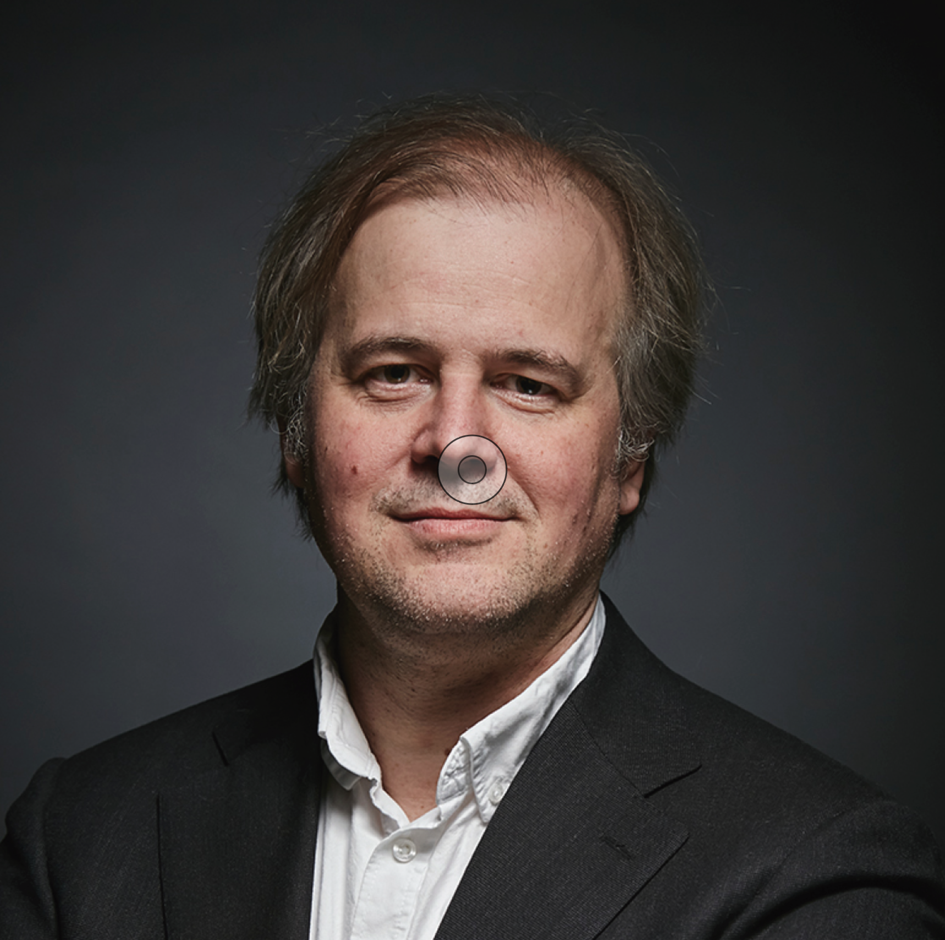
Newsletters
SEC Monthly
Centre and Partner activities
omEV
Analysis of the global electromobility field - issued several times a week
”
omEV is the key provider of
insights about research, policy,
and market development of the
global e-mobility landscape for
Swedish stakeholders.
Magnus Karlström, Chief Editor omEV

Slide 14

Newsletters
Sign-up:
https://omev.se
https://emobilitycentre.se
SEC Monthly
Centre and Partner activities
omEV
Analysis of the global electromobility field - issued several times a week
Follow:
/emobilitycentre
”
omEV is the key provider of
insights about research, policy,
and market development of the
global e-mobility landscape for
Swedish stakeholders.
Magnus Karlström, Chief Editor omEV

