Slide 1
Sweden's Part in EU's 4th Pilot Line Professor Mikael Östling

Slide 2
In the first Call of the Chips JU, 4 Pilot Lines are granted €1.67 billion over 5 years
European Pilot Line for beyond 2nm leading edge System-on-Chip leadership
FD-SOI Pilot Line for Applications with non-volatile embedded Memories, RF & 3D integration, to ensure European Sovereignty
Advanced Heterogeneous System Integration Pilot Line
WBG Pilot Line

Slide 3
Focus of the PL
Sub 2nm leading-edge system on chip technology: Concentrating on cutting-edge technology for advanced semiconductors at sizes of 2 nanometers and below, crucial for various applications, including computing, communication devices, transport systems, and critical infrastructure.
Fully Depleted Silicon on Insulator technologies targeting 7 nm: Aiming to develop a roadmap towards 7 nm transistor architecture with distinct advantages for high-speed and energy-efficient applications.
Packaging and Heterogenous Integration: This initiative seeks to combine semiconductor materials, circuits, or components into compact, high-performance systems.
Semiconductor devices based on Wide Bandgap semiconductors: Focusing on materials enabling electronic devices to operate at higher voltage, frequency, and temperature than standard silicon-based devices, to develop highly efficient power, lighter weight, lower costs, and radio-frequency electronics.

Slide 4
The Story Behind the Scenes
The three big PL
Why the 4th PL?
The Italian Connection
The Draft Proposal
The Evaluation

Slide 5
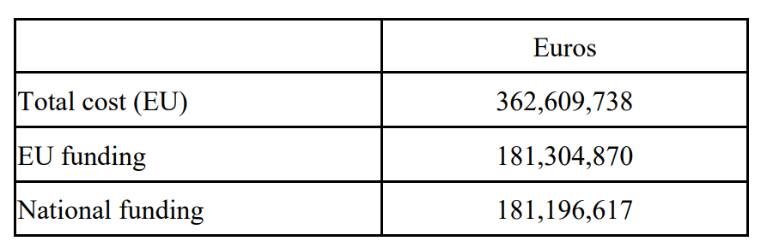
Budget over 5 years
Total budget requested from EU €181,2M
Sweden total budget requested from EU €13,5M
KTH total budget requested from EU €4,5M

Slide 6
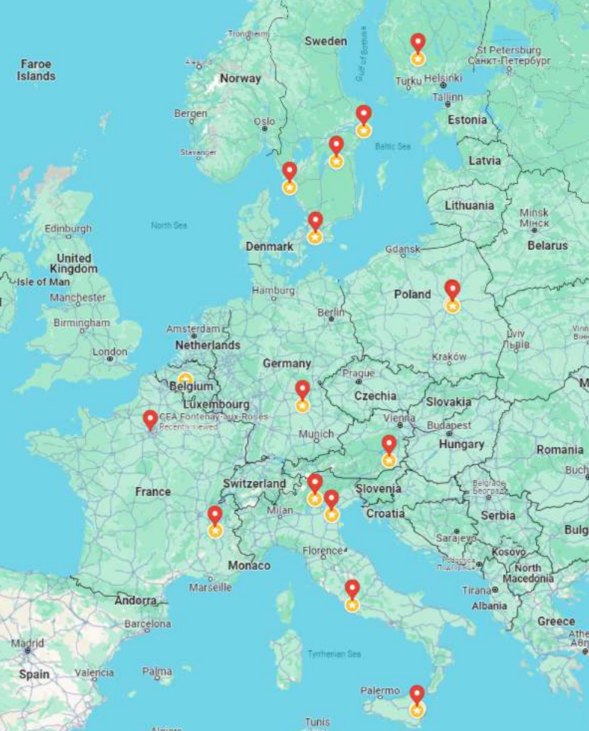
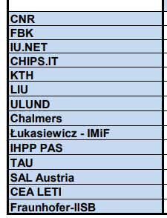
Participating organizations

Slide 7
Ambitions and goals
The first results coming from the WBG pilot line will be the improvement of the efficiency of the high–end portion of the advanced power discrete device portfolio in Europe, and the development of the related value chain based in Europe.
The second effect will be the creation of new and very innovative product families based on modern semiconductor materials and power devices having features and performance not covered by the current market

Slide 8
The main general objectives of The WBG pilot line
to develop advanced processes for materials growth and device fabrication for WBG and UWBG semiconductors;
to develop and demonstrate process flow, with a high level of automation, yield, and throughputwith industrial manufacturing standards; , compatible
to develop enabling process and integration techniques for devices in a cost–effective manufacturing environment;
to design and manufacture in small volumes application-driven device demonstrators to validate their manufacturing readiness level and establish their commercial value and potential for targeted markets

Slide 9
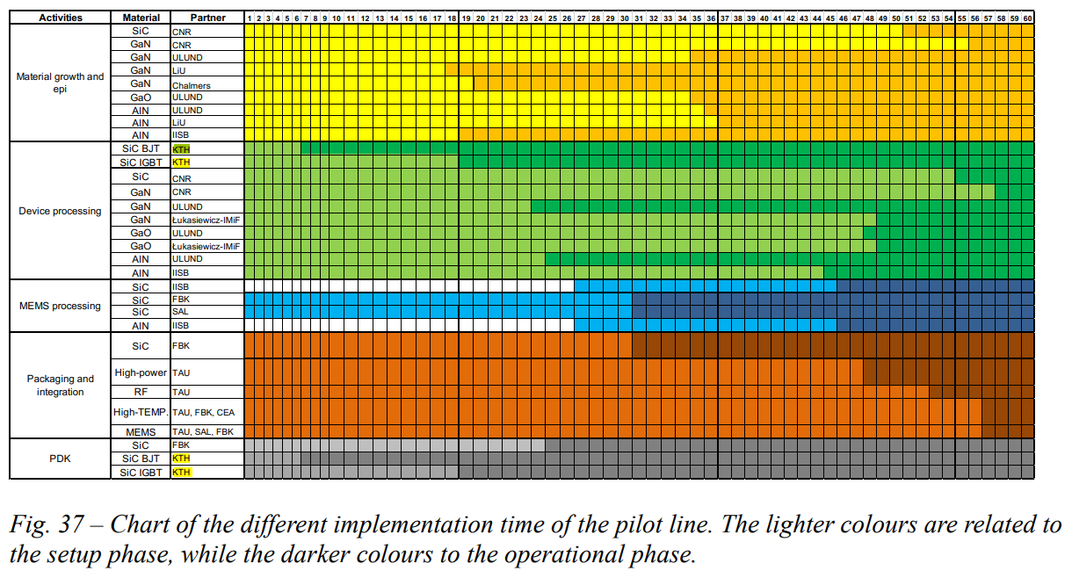

Slide 10
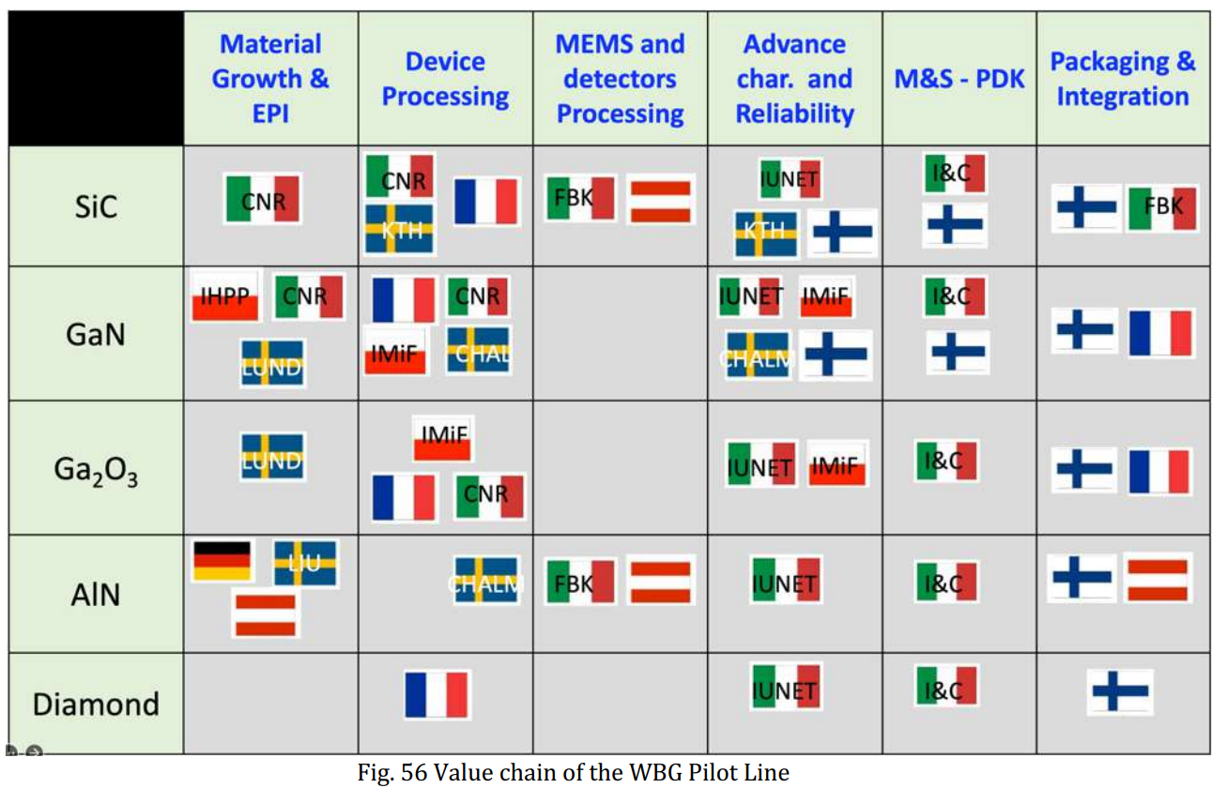

Slide 11
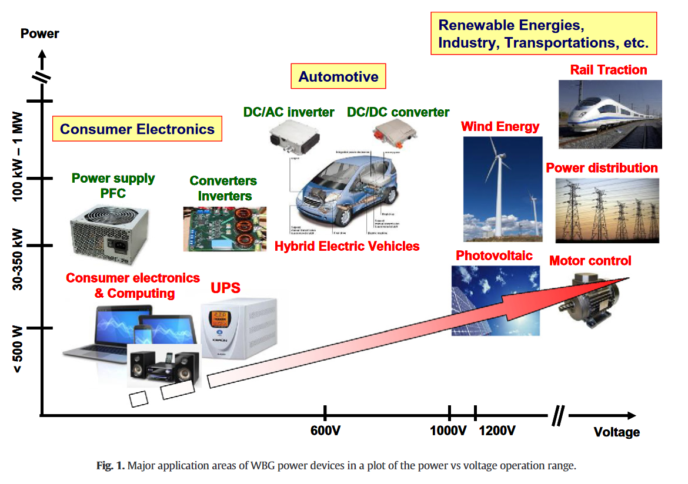
Power Electronics by WBG

Slide 12
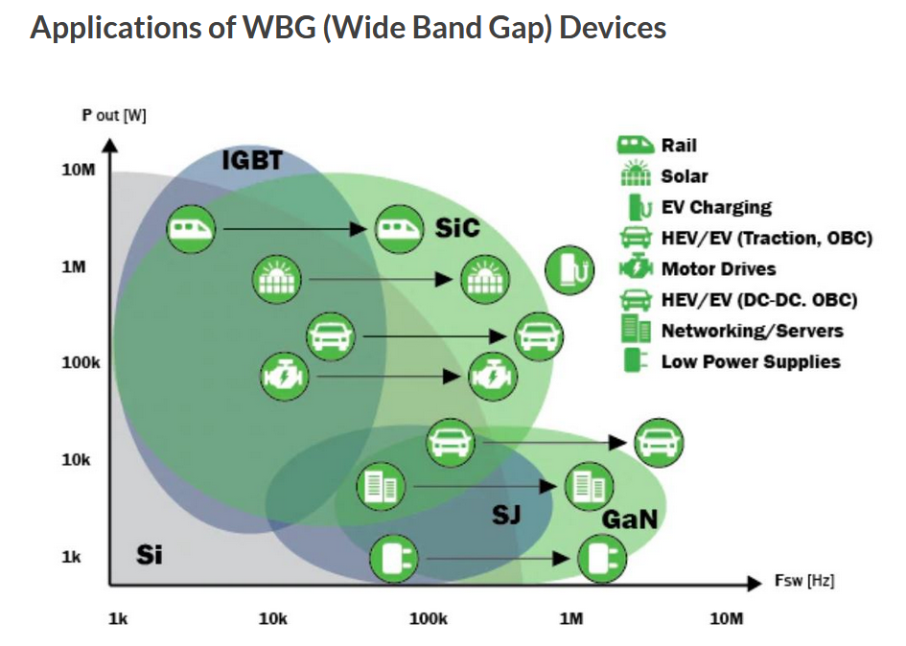
Power Electronics by WBG

Slide 13
How about power efficiency ?
More than 63% of the generated electrical energy is produced by fossil based fuel
Urgent to change the energy mix in a sustainable way
At the same time we need to improve the efficiency in both the way we produce the electrical energy and how efficient we can distribute and consume the energy
One important technology to improve power electronic efficiency is to introduce Wide Bandgap Semiconductors, such as SiC and GaN in our future technology
By improving today’s power electronics efficiency by only 1% will reduce the consumption by 250 TWh – about 75 typical coal powered plants !
→

Slide 14


Slide 15
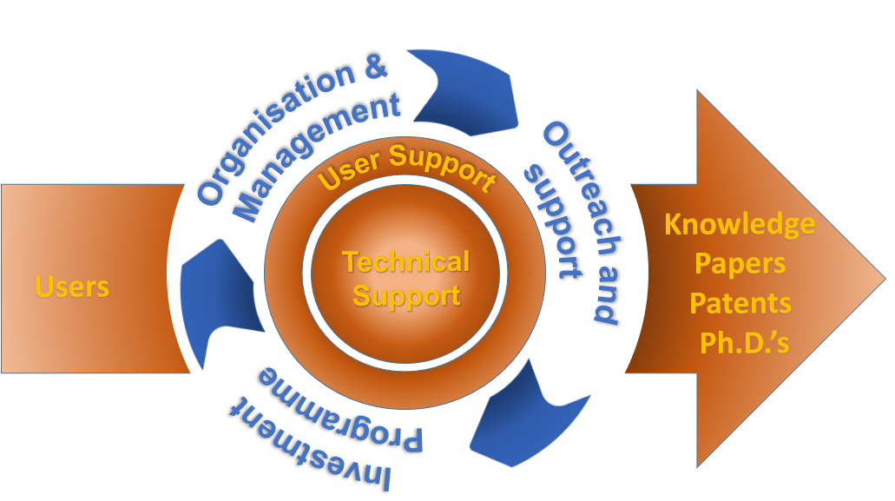
Myfab – Sweden’s Open-Access Nanotechnology Research Infrastructure
750 instruments – 835 active users – 123 companies/institutes (2020–2022)
Myfab’s impressive annual output
800 peer-reviewed publications (> 2/day)
60 doctoral thesis (> 1 every 6:th day)
1/3 of the users are new users every year
During a 5-year period
20–30 start-ups
On-going prestigious grants (2022)
24 ERC grants
30 KAW grants
Myfab’s mission is to provide Swedish researchers, entrepreneurs and industry with leading-edge micro- and nanofabrication equipment in a nationally distributed infrastructure of operationally excellent cleanroom facilities, supported by expert and collaborative staff.
Myfab offer
Individual user-fee based access
Training and education
Process service and collaboration
Myfab characteristics
Distributed National Research Infrastructure: four large cleanroom-based laboratories. Decreases the need of travel
Networking excellence – synergy driven: management + expert + user + technical levels nationally and in Nordic Nanolab Network and EuroNanoLab:
transfer of best practices, knowledge, strategies, redundancy & back-up, problem solving, education ….
Synthesis = physical fabrication, i.e. creation of materials, structures, devices, small systems
Processes involving many fabrication steps and expert knowledge
Used by the whole value chain: from low to high TRL
Setting standard for efficient and open user access,
essentially no waiting – no 2nd selection, just book and use!
Finland
Sweden
Norway
Myfab Uppsala
Uppsala
Myfab KTH
Gothenburg
Stockholm
Myfab Chalmers
Denmark
Lund
Myfab Lund
Strategic relevance – Swedish opportunities
Chips Act – possibility for pilot lines in Myfab
Quantum Technology
Nanomedicine
74 (58 FTE) highly trained support personnel, 35 with a PhD
5400 m2 total cleanroom area
Myfab LIMS – the leading tool for booking, logging, information, statistics, and planning
1.7 M€/y and 10.5 M€ investment grant for 2020-2024 from the Swedish Research Council. Turnover 22 M€ (2021)
Research: 86% Commercial:14%
Backup and redundancy, expert profiles and geographic coverage
Specialization - lab specific expert profiles
Backup - nanofabrication generic tools
Within 60 min travel for 4.4 million people

Slide 16
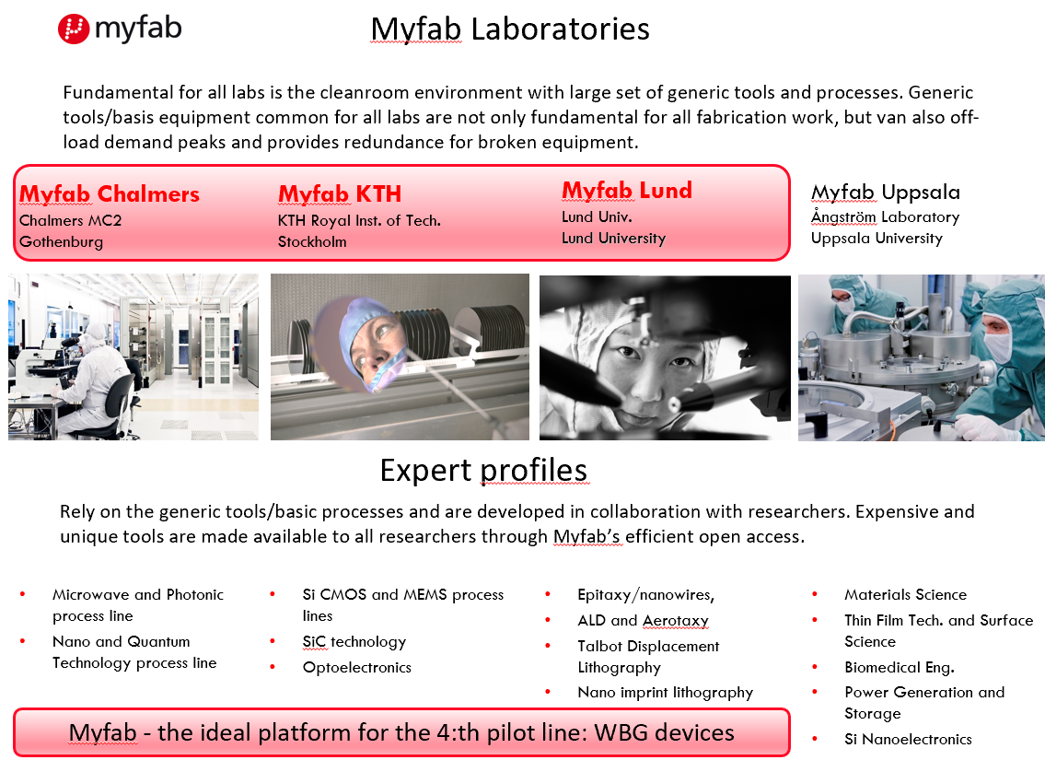

Slide 17



WBG pilot line – Swedish III-N and Gallium Oxide contribution
Swedish III-Nitride Technology Cluster
Chalmers, LiU and Lund University
www.c3nit.se

Slide 18
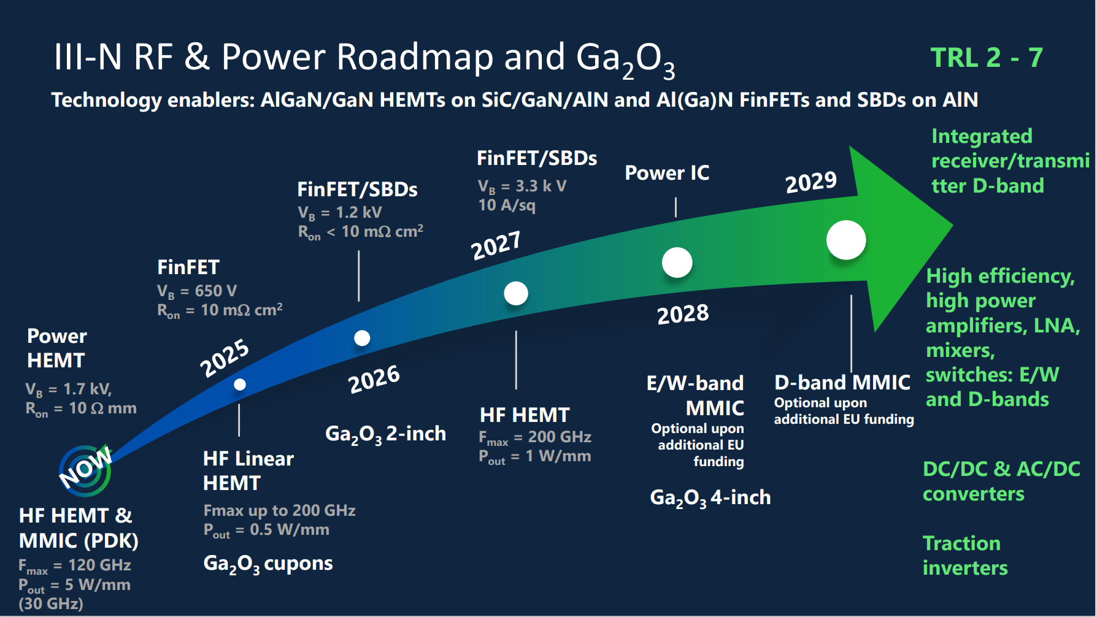

Slide 19
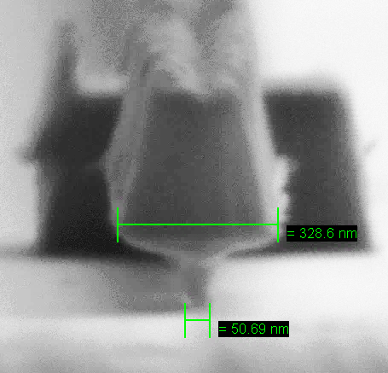
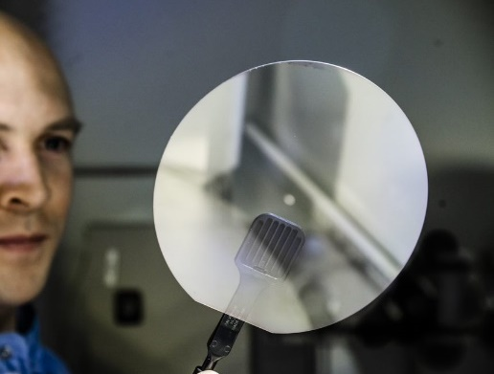
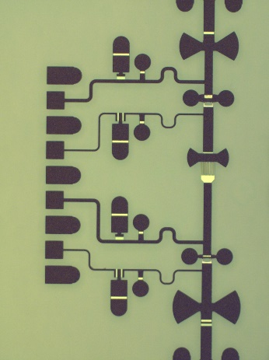

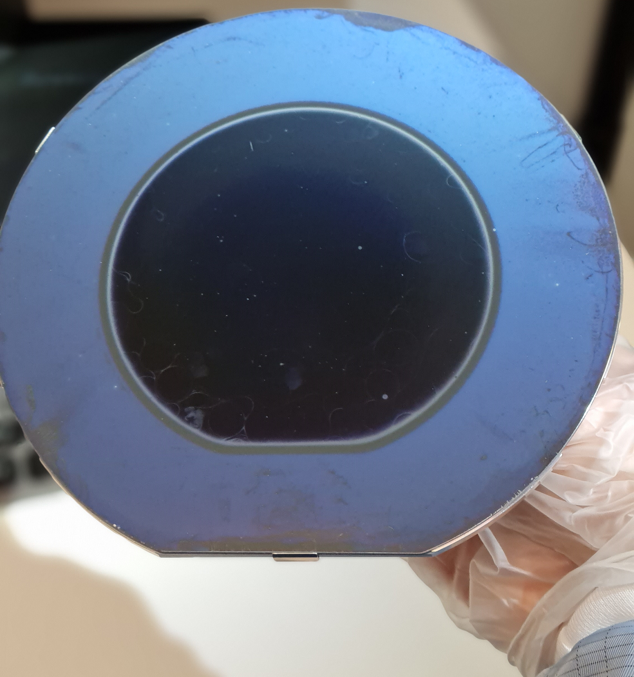
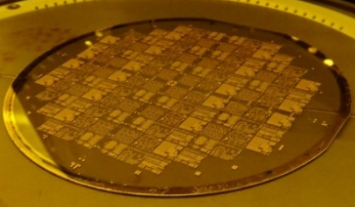
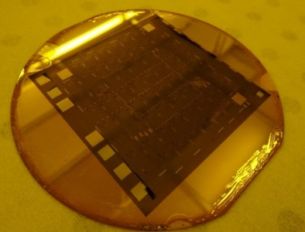
Swedish III-Nitride Technology Cluster
Swedish III-N Pilot line offers
III-N HEMT epi-wafers incl. SI SiC (150mm)
HEMT device technology
GaN and ALN process modules
MMIC design kits
MMIC process
State-of-the-art GaN-on-GaN material technology
State-of-the-art III-N-on-AlN material technology
GaN and AlN SBDs and FinFETs
GaN/Gallium Oxide MOCVD reactors
Training and education on pilot line

Slide 20
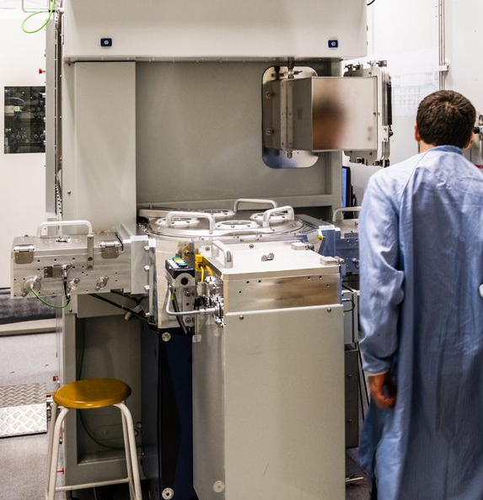
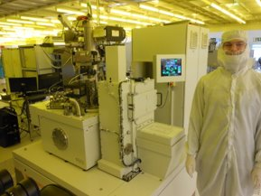
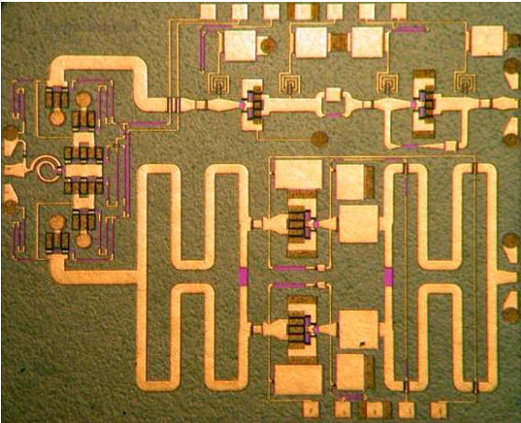
Swedish III-Nitride Technology Cluster
Swedish III-N Pilot line
The pilotline operate under a fully open access policy in accordance with our national microfabrication infrastructure Myfab.
Myfab Chalmers and Lund, operate the Microwave and photonics process line, and the III-V process line including a complete set of tools for growth of GaN, AlN and Gallium Oxide and processing GaN-HEMT and FinFET devices and circuits. LiU MOCVD lab on the way to Myfab.
The pilot line can also assist in process development.
The pilot line operate at TRL levels 2 to 7.
III-Nitride cluster total budget € 18.2M

Slide 21
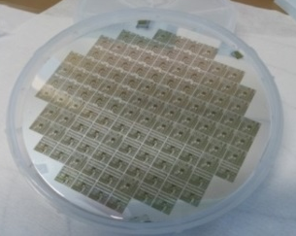
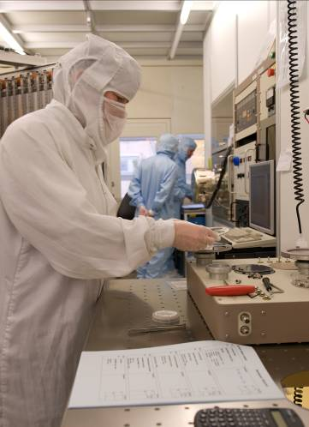
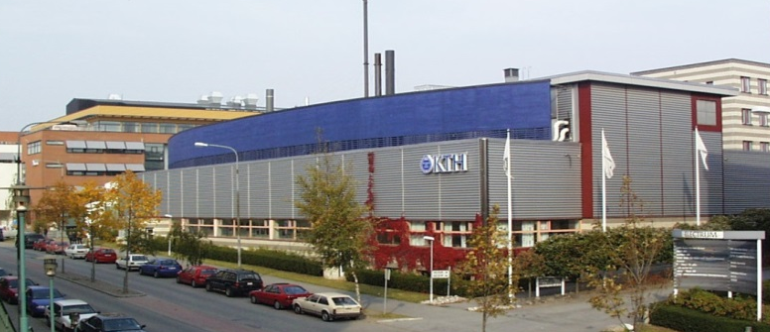
KTH Cleanroom for IC and Device Fabrication
Electrum Laboratory 1300 m²
ISO 9001 certified / controlled processes and calibrated characterization tools
100 – 200 mm wafers
Silicon Technology
Silicon – IC, FD SOI
Silicon - Microsystems
Compound Semiconductors
SiC – Electronics, 100 mm
InP - Opto / electronics
GaAs - Opto / electronics

Slide 22
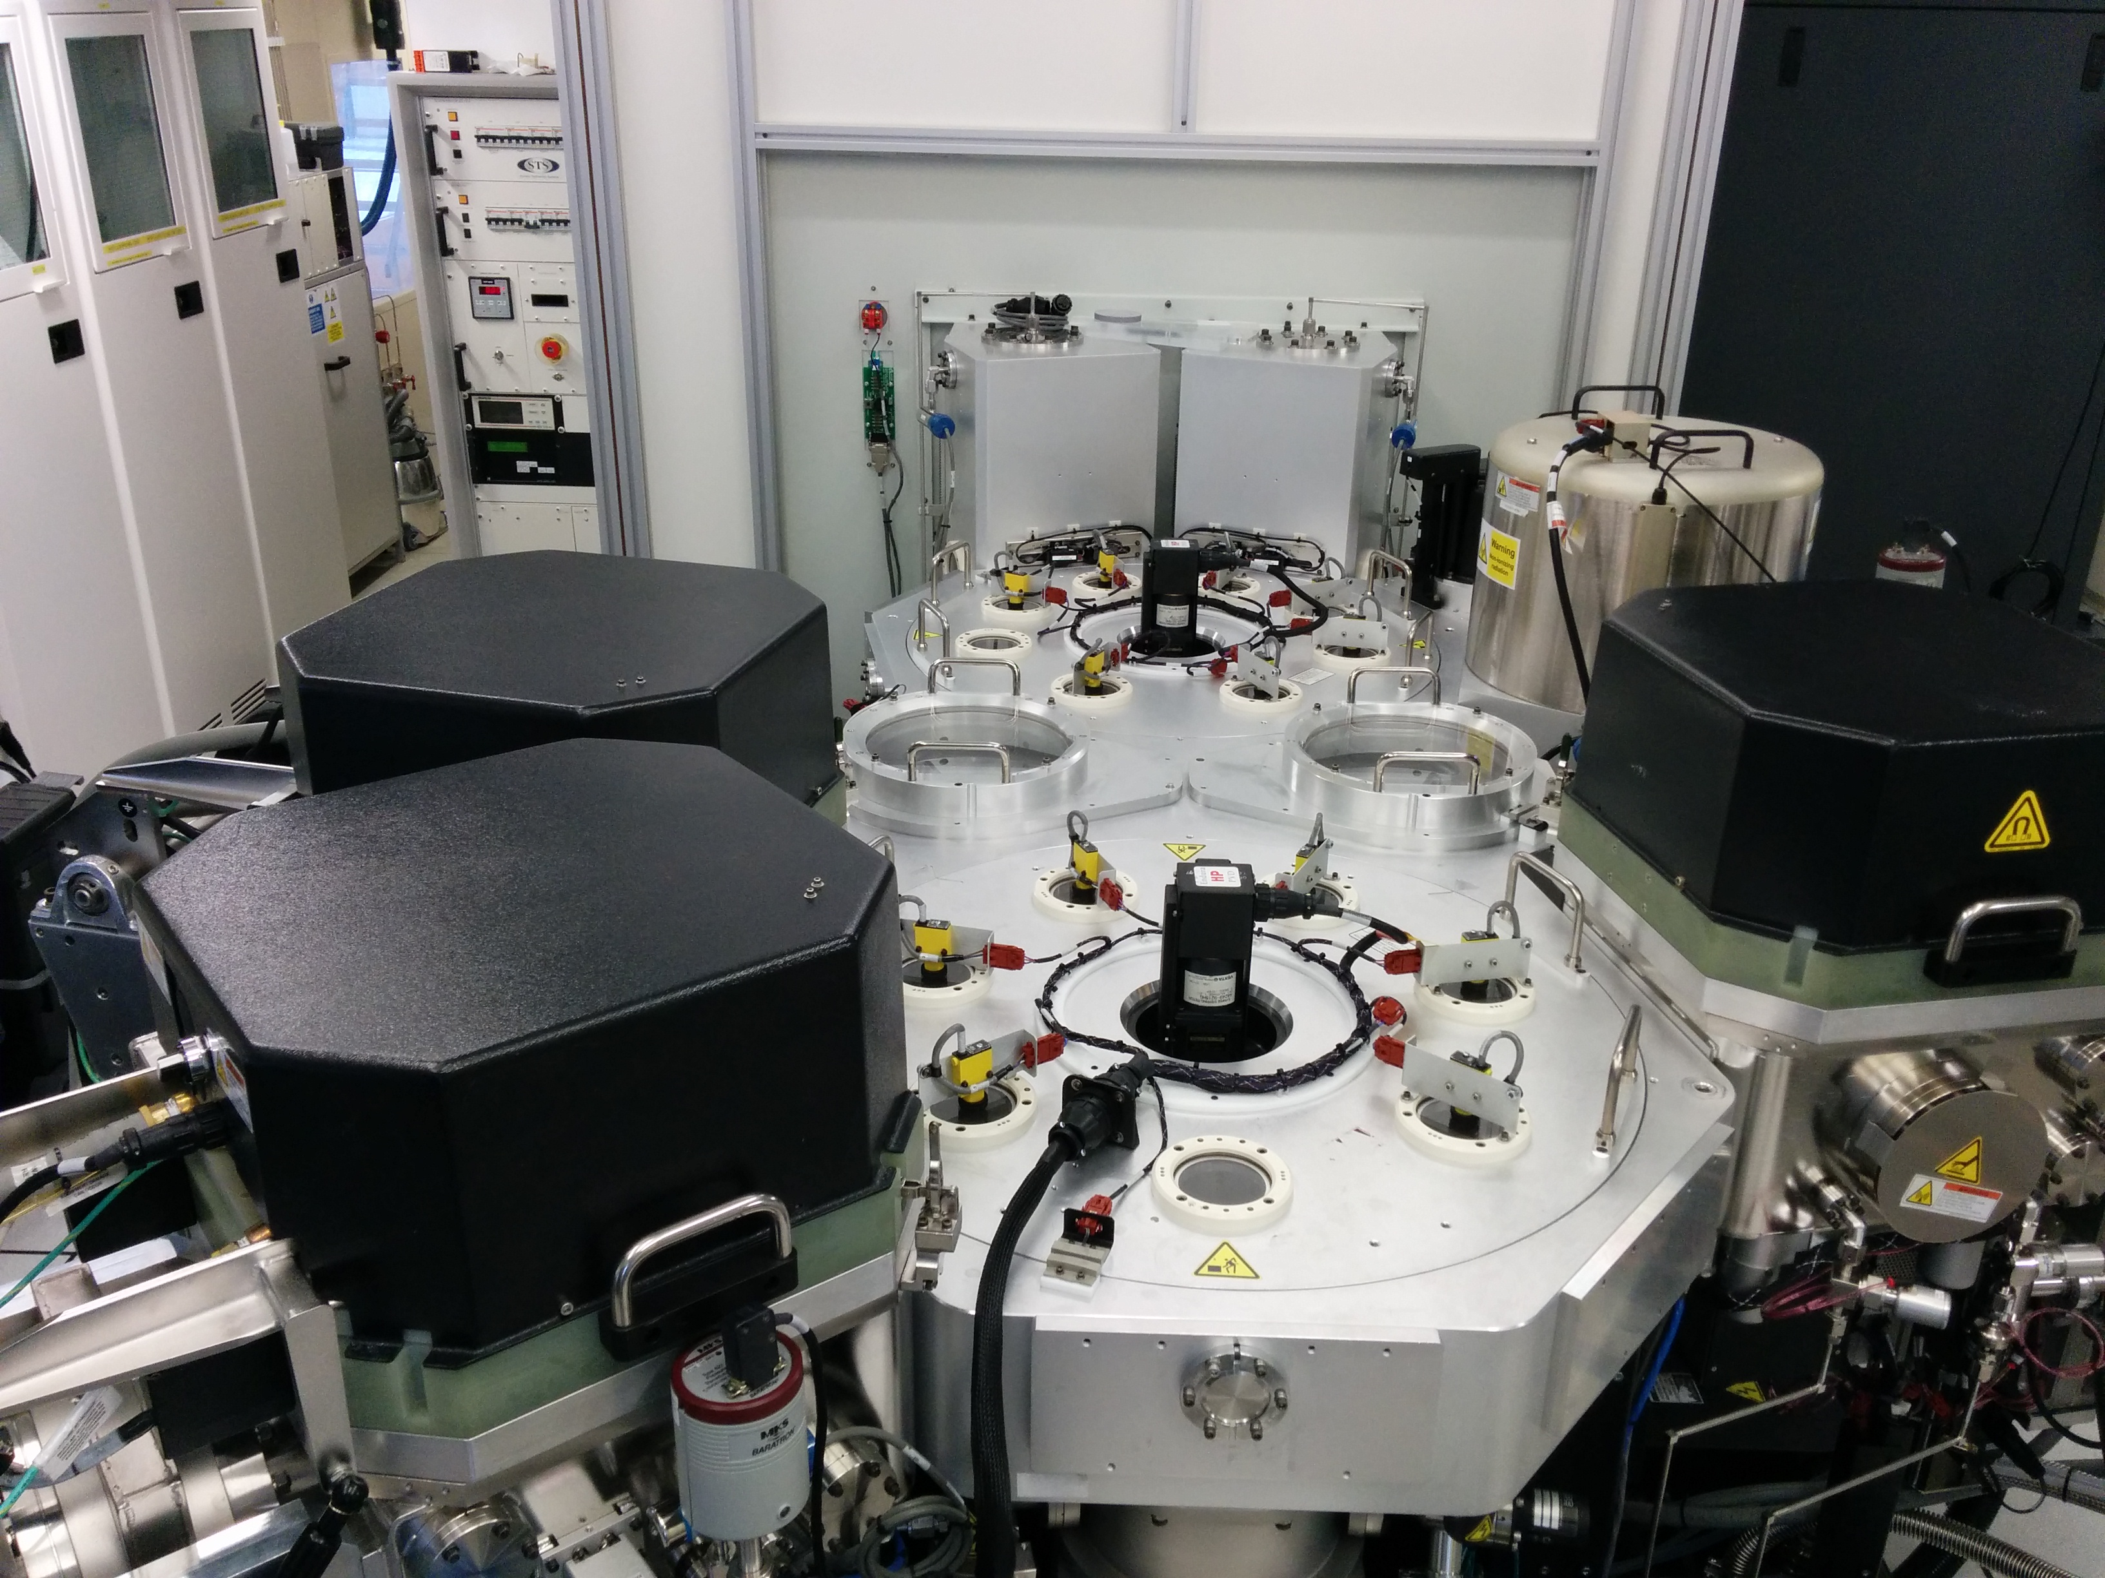
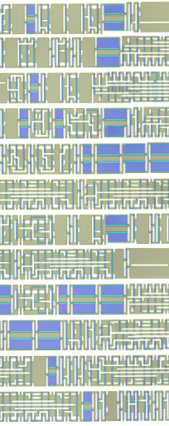
FDSOI CMOS line
FDSOI CMOS digital PDK in Cadence
Litho: Nikon TFHi12, λ=365 nm
MERIE: SiO₂/SiN: AMAT P5000
MERIE: Al/TiW/TiN: AMAT P5000
PECVD: SiO₂/SiN: AMAT P5000
LPCVD: p and n doped poly-Si
ALD: SiO₂/HfO₂/TiN: BENEQ TFS200
PVD: Ni/TiW/AL: AMAT Endura
RTA: Annealsys AS-One
Oxidation/Diffusion: Thermco 2800

Slide 23
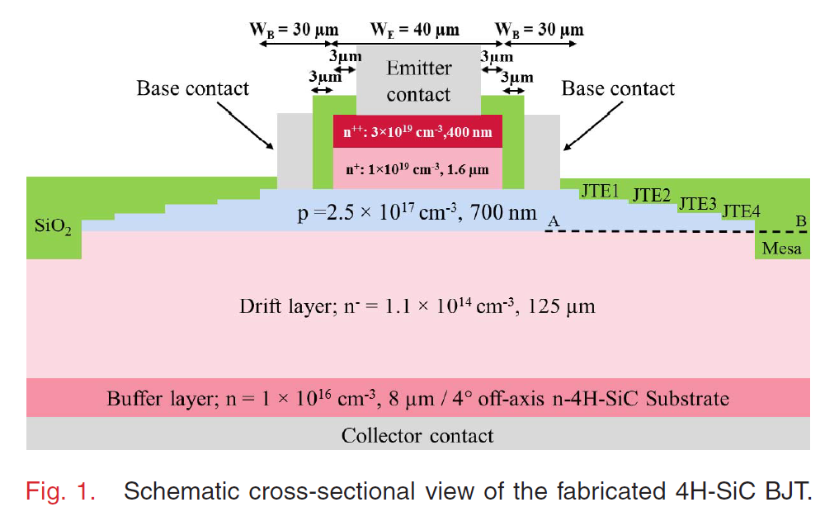
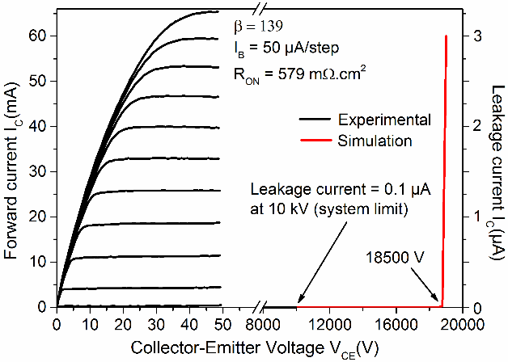
KTH Contribution to the WBG Pilot Line: High Voltage SiC BJTs and IGBTs (>3.3 kV)
Mikael Östling, Per-Erik Hellström and Mattias Ekström
A. Salemi, H. Elahipanah, K. Jacobs, C. -M. Zetterling and M. Östling, "15 kV-Class Implantation-Free 4H-SiC BJTs With Record High Current Gain," in IEEE Electron Device Letters, vol. 39, no. 1, pp. 63-66, Jan. 2018, doi: 10.1109/LED.2017.2774139.
The pilot line will initially deliver devices based on the the available high current gain (β>130) SiC BJT technology that has been demonstrated to sustain up to 15 kV of collector-emitter voltage .
The pilot line will initially offer BJT devices for 3-5 kV (TRL level 5) on 150 mm SiC wafers.
Technology development will bring 15 kV devices, currently at TRL 4 to TRL 5-6.
In house available innovative, basal plane dislocation-free, 150 mm SiC substrates from KISAB (https://kisabsemi.com) and SiC epitaxy (Coherent)
The pilot line will also develop IGBT devices on KISABs p-type SiC substrates to be available to the pilot line after the qualification of the BJT devices.

Slide 24
Task 6.3: SiC Power devices (KTH; M1-M60)
Subtask 6.3.1 Set up SiC BJT process line for high-voltage devices between 3.3 to 15 kV (M1-6).
Subtask 6.3.2 Develop and set up SiC (<15 kV) IGBT devices (M18-M42).
Subtask 6.3.3. Yield enhancement and fabrication cycle-time reduction (M1-48).
Subtask 6.3.4 Enabling packaged devices for high-power applications (M1-48).
Subtask 6.3.5 Deliver SiC BJTs and IGBT devices to users of the pilot line (M1-60).

Slide 25
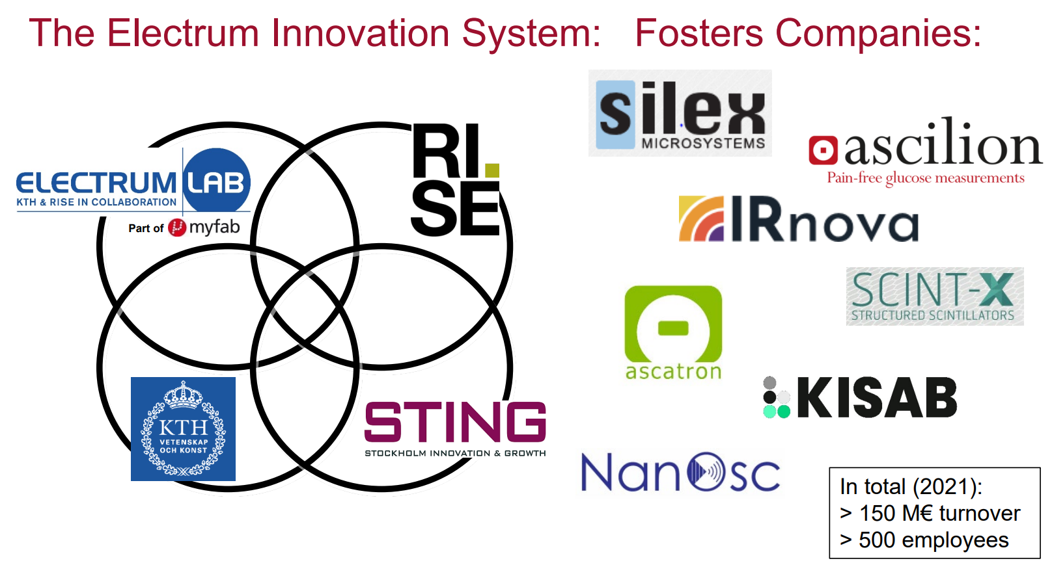

Slide 26
